Slide 1
Many-Field Packet Classification for Software-Defined Networking Switches
Authors: | Cheng-Liang Hsieh, Ning Weng
Publisher: | 2016 ANCS
Presenter: | Tzu-Chieh, Lin
Date: | 106/12/20

Slide 2
INTRODUCTION
Packet classification is a core problem for OpenFlow-based software-defined networking switches, which required 38 packet header fields per flow to be examined against thousands of rules in a ruleset.
The requirements on latency, throughput, update cost, and storage for a system like OpenFlow Switch become stricter with the increasing complexity of a ruleset.
Hence, packet classification remains an open and challenging problem for next generation network device development.

Slide 3
BACKGROUND

Slide 4
Ternary Content-Addressable Memory Solutions
TCAMs leverage hardware parallel computation power to generate high packet classification throughput, they suffer problems such as high power consumption, high manufacturing cost, and low scalability.

Slide 5
Tuple Space Solutions
Tuple space solutions are software-based and they leverage the fact that the number of distinct tuples is much less than that of rules in a ruleset.
Tuple-space-based solutions efficiently compress a ruleset by storing those valid bits of each field only. Besides, tuple-space-based solutions perform the search of each tuple independently and take advantage of parallelism.
With the growth field number in a ruleset, both tuple number and tuple size increase. A longer processing latency could be expected.

Slide 6
Decomposition-based Solutions
Decomposition-based solutions work on each field in a ruleset independently and merge the intermediate results from different fields as the final match result.
Since each field is processed individually, more intermediate results will be generated with the growth of field number in a ruleset.
The increasing merge stages of those additional fields in a ruleset result in a bigger memory requirement and longer processing latency.

Slide 7
Decision-tree-based Solutions
Decision-tree-based approaches analyze all fields in a ruleset to construct decision trees for efficient packet header lookup.
Tree depth and rule duplication in a decision tree affect the searching efficiency and memory requirement of one implementation.
Both of them increase with the growth of field numbers which results in an exponential increase of memory requirement and increasing processing latency.

Slide 8
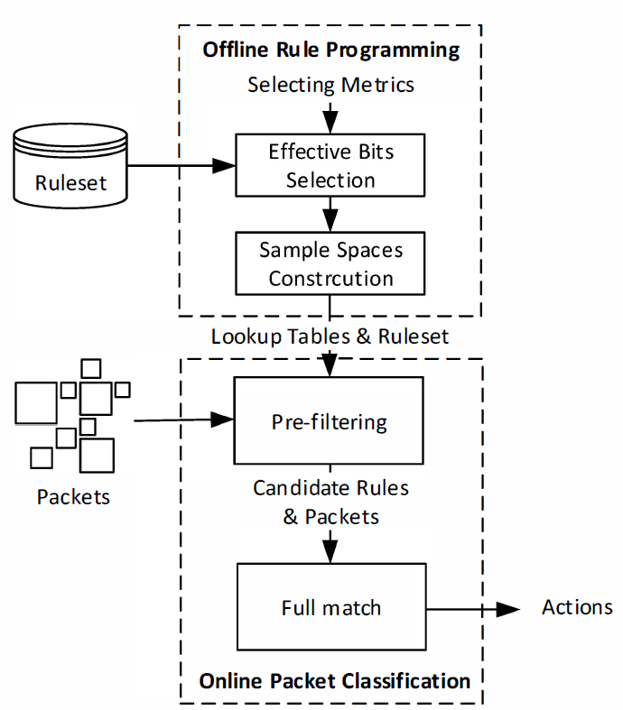
MC-SBC ARCHITECTURE
Packet classification multidimensional-cutting via selective bit-concatenation (MC-SBC) is implemented as a two-stage classification system with an off-line rule programming process to construct the lookup tables for the following on-line packet classification process.

Slide 9
Off-line Rule Programming
It stores the partition results of a ruleset into these lookup tables with rules' ID and uses effective bits as indices to access them. These effective bits are selected to provide the best discrimination between rules in a ruleset.
To update lookup tables with low cost, each lookup table is stored discretely in system memory with two reference tables: the quantity table and the address table.
The address table tells the memory address of each location in a lookup table. The quantity table tells the number of rule IDs in that location.

Slide 10
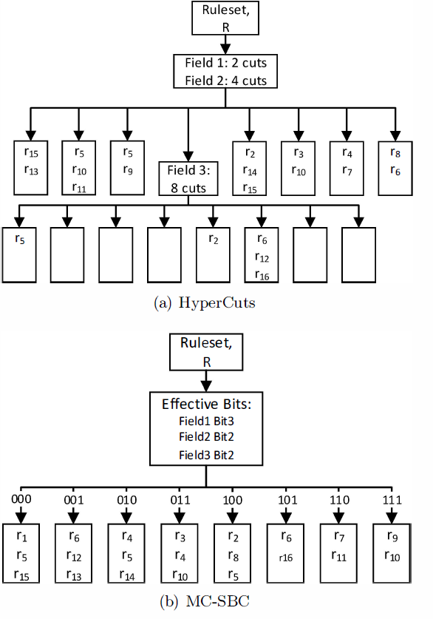
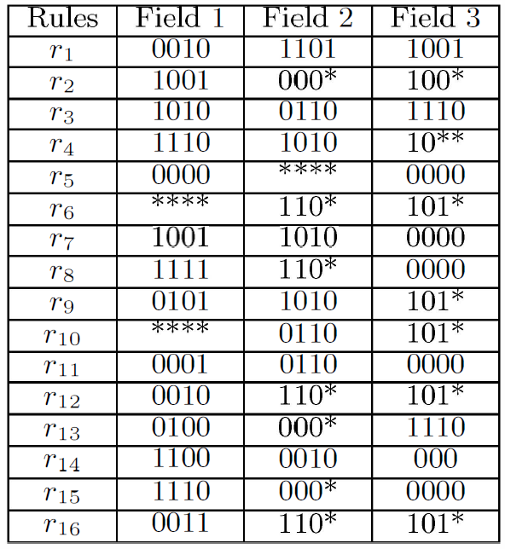

Slide 11
On-line Packet Classification
The on-line packet classification contains two processes: the pre-filtering process and the full match process.
The pre-filtering process is designed to find the related rule IDs for an incoming packet. It takes the values of effective bit position in a packet as lookup table indices and checks with pre-computed lookup tables for preliminary results.
Lookup results from different tables are merged to come out candidate rule IDs. All candidate rule IDs are then forwarded to the full match stage.

Slide 12
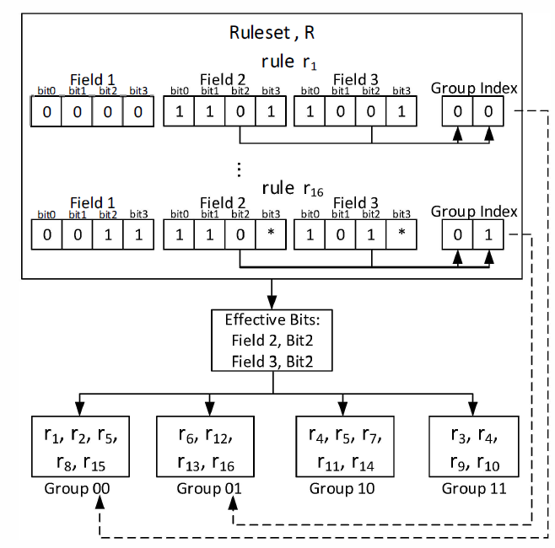
Lookup tables construction
MC-SBC collects the target rules by putting rules with same attributes into a smaller subset and gives each subset a group index.
When doing a lookup, MC-SBC can only check those rules with same attributes by using group indices without wasting resources on those unrelated rules.

Slide 13
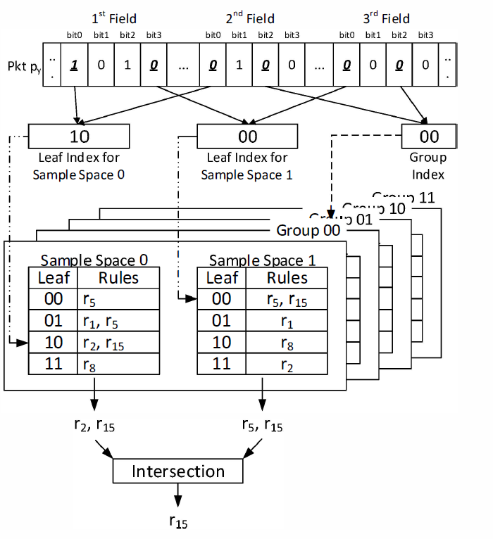
Pre-filtering
The pre-filtering process merges the lookup results from each sample space to extract candidate rules for the full match process.
The pre-filtering process then extracts candidate rules from the lookup results of different sample spaces for the following full match process.

Slide 14
SELECTING METRICS FOR EFFECTIVE BIT POSITION
The aim of MC-SBC is to make the subsets' sizes as small as possible and to distinguish different rules in an efficient way.
Therefore, for a set of effective bit positions, any two of them are designed to be with low wildcard ratio (${P_{∗∗}}^{(i,j)}$) and high diversity ($Div$) to lower the total number of duplicated rules.
Besides, the independence index ($Ind$) between any two bits is designed to avoid possible bias of data structure.

Slide 15
Wildcard Ratio
Wildcard ratio measures how many wildcard symbols (*) appear on two chosen bit positions in a ruleset.
A higher wildcard ratio for a bit position means there are many wildcard symbols on this bit position and more duplications are produced.
$${P_{∗∗}}^{(i,j)}=\frac{{N_{∗∗}}^{(i,j)}}{N}$$
$$N is the number of rules in a ruleset, i and j are for bit positions in a ruleset.$$

Slide 16
Independence Index
Bit positions with low correlations to each other can draw good distinctions between different rules when checking sample values, and independence index ensures that different bit positions are with high independence to each other.
$${Ind}^{(i,j)}=\sum_{x=0,1,∗}{\sum_{y=0,1,∗}{P_{xy}^{ij}−P_{x}^{i}∙P_{y}^{j}}}$$
MC-SBC chooses a set of effective bit positions to guarantee the high independence among them.

Slide 17
Diversity Index
Diversity index ensures the distribution of rule number in the subsets is even for better performance and lower processing latency.
$${Div}^{i}=−\frac{P_{0}^{i}}{1−P_{∗}^{i}}\log{\frac{P_{0}^{i}}{1−P_{∗}^{i}}−\frac{P_{1}^{i}}{1−P_{∗}^{i}}\log{\frac{P_{1}^{i}}{1−P_{∗}^{i}}}}$$
With a high diversity index, the subset sizes are distributed more evenly, and if the subset sizes are with uniform distribution, the processing latency under the worst case can be greatly reduced for a given duplication.

Slide 18
Effective Bits Selection
For an effective bit position set, MC-SBC finds any two bit positions where $Div$ is big, $Ind$ is small, and $P_{∗∗}$ is small. Here, $R^{(i,j)}$is denoted as the bit position j in field i of a ruleset R.
For the ruleset as in Table 1, $R^{(1,0)}$, $R^{(1,1)}$, $R^{(1,2)}$, $R^{(1,3)}$, $R^{(2,0)}$, $R^{(2,1)}$, $R^{(2,2)}$, $R^{(3,0)}$, and $R^{(3,2)}$ are with higher $Div$ indices compared to other bits for an effective bit position set.
However, if $R^{(1,0)}$, $R^{(1,1)}$, $R^{(1,2)}$, $R^{(1,2)}$ or $R^{(2,0)}$, $R^{(2,1)}$, $R^{(2,2)}$ are in the same set, a higher $P_{∗∗}$ index of that set is found and it results in a higher rule duplication.

Slide 19
Hence, there are at most two sets with up to 3 elements in each set:
$${\{ R}^{(1,0)}∨R^{\left(1,1\right)}∨R^{\left(1,2\right)}∨R^{\left(1,3\right)}, R^{\left(2,0\right)}∨R^{\left(2,1\right)}∨R^{\left(2,2\right)}, R^{\left(3,0\right)}∨R^{\left(3,2\right)}\}$$
or at most 24 26 sets with up to 2 elements in each set.
To decide the of the elements in a set, $Ind$ indices are used ${\{R}^{\left(2,2\right)},R^{\left(3,2\right)}\}$, ${\{R}^{\left(1,0\right)},R^{\left(2,0\right)}\}$and ${\{R}^{\left(1,3\right)},R^{\left(3,0\right)}\}$are found as effective bit position sets which have smaller $Ind$ values.

Slide 21
Experimental Results
All experiments are conducted on an Intel Xeon E5410 CPU machine with 4GB DDR2 RAM as the main memory. This machine is equipped a NVIDIA K20C GPU with 13 streaming multiprocessors (SMXs) and 5Gb GDDR5 memory for general computation.
All necessary packets and tables are assumed to be ready on GPU before the packet classification process starts.
In this paper, the synthetic rulesets are generated by taking ClassBench ruleset for the traditional 5-tuple first . We attach 10 additional fields with wildcard ratio as 0.1 to create the synthetic rulesets for the experiments.

Slide 22
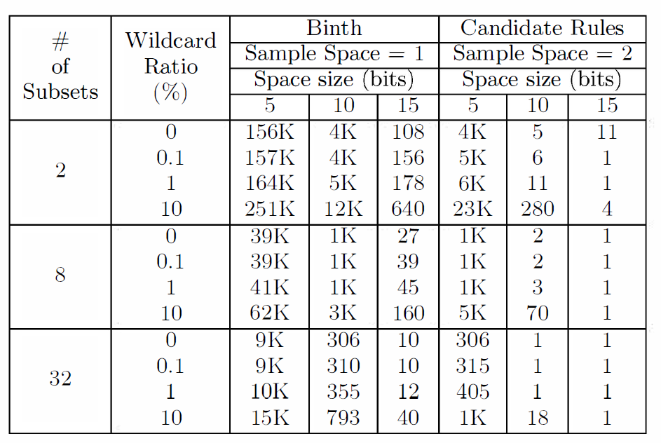

Slide 23
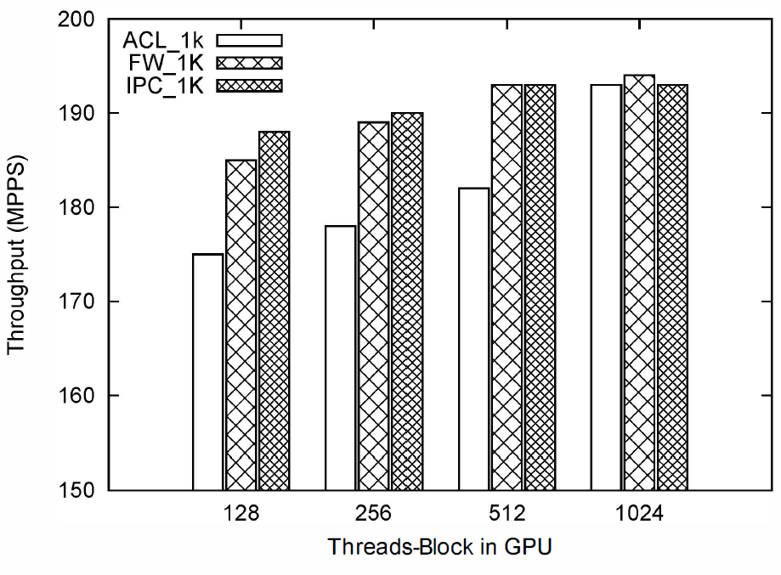

Slide 24
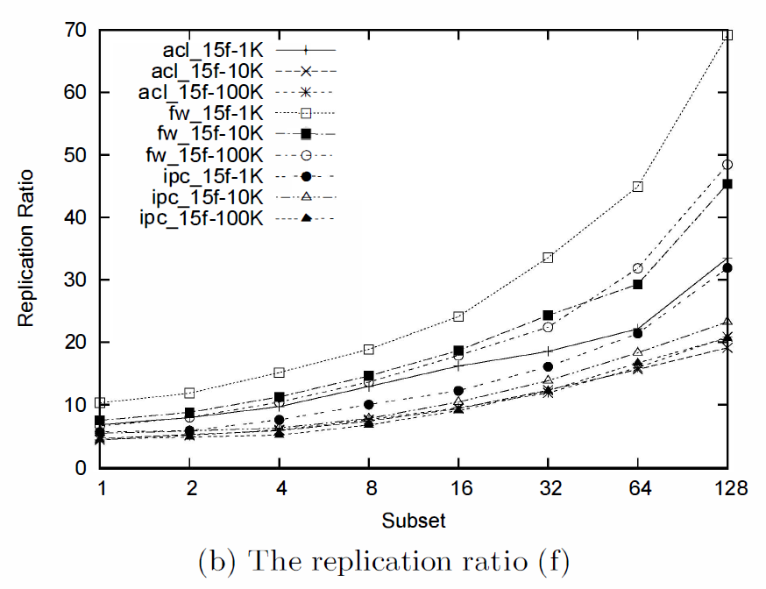
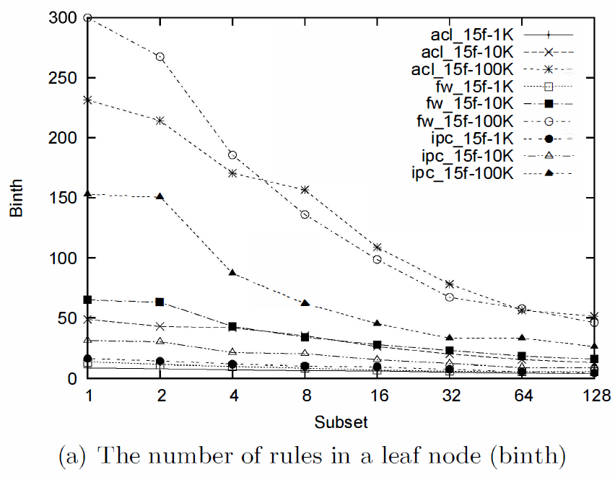

Slide 26
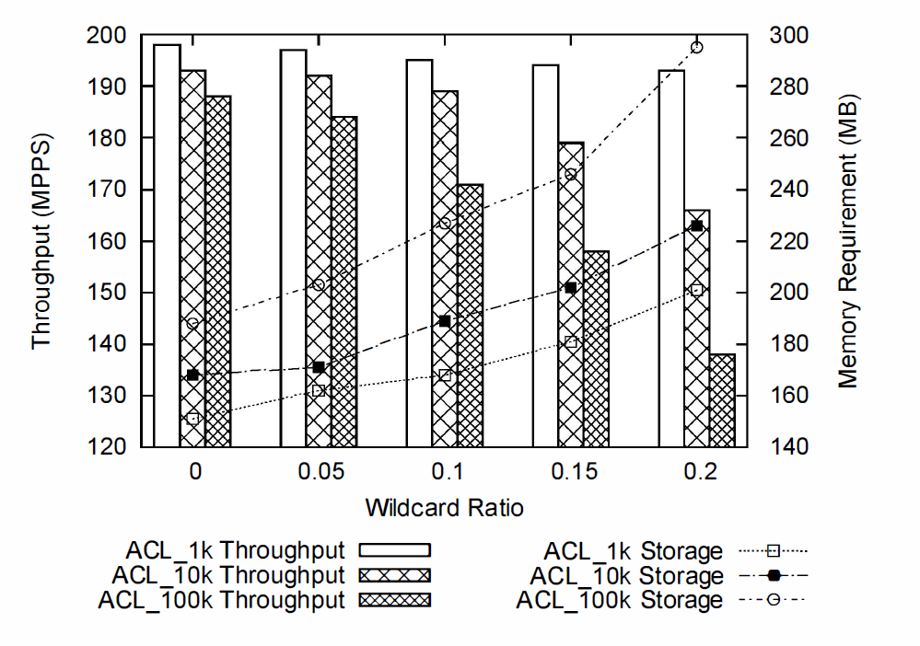

Slide 27
